Slide 1
MAGNETIC LOOP DIY
BY
B EVANS
M0XAG

Slide 2
MATERIALS AND METHODS
CIRCUMFERENCE 4 METRES
DIAMETER 22MM
MATERIAL COPPER
LOOP DIAMETER 1.3 METRES
MIN CAPACITANCE 32 Pf
MAX CAPACITANCE 610 Pf

Slide 3
HISTORY

Slide 4
IS THIS RON......

Slide 5
THE LOOP TO START////////

Slide 6
CAPACITOR CONNECTION

Slide 7
2” SOLVENT WELD FRAME....

Slide 8
FRAME & DRIVEN ELEMENT MOUNTED...

Slide 9
FIRST REMOTE DRIVE PROTOTYPE

Slide 10
1 HUNG LOW MOTOR CONTROLLER

Slide 11
FLOOR STAND BUILT

Slide 12
DIY CAPACITOR IN BOX WITH MOTOR FIRST ATTEMPT...

Slide 13
2ND ATTEMPT PULLEY DRIVE.....

Slide 14
FINISHED LOOP

Slide 15
CONTROL BOX

Slide 16
LOOP EFFICIENCY.

Slide 17
BANDWIDTH

Slide 18
CA Pf

Slide 19
CAP VOLTS

Slide 20
Q FACTOR

Slide 21
TRANSMISSION PATTERN.......

Slide 22
MINIMUM LOOP MONO BAND
BAND SPREAD | BAND | CIRCUMFERENCE | DRIVEN ELEMENT | LOOP DIAMETER(PII) MAIN | CAPACITOR VALUE +/- | EXPECTED BANDWIDTH | cap voltage | EFFICIENCY VARIATION
1.8-2 MhzZ | 160 | 16 | 3.2 | 5.1 | 522-420 pf | 2.4 khz | 3.8kv | 17-23 %
3.5-4Mhz | 80 | 8 | 1.6 | 2.5 | 302-230 pf | 3.7 khz | 3.8kv | 21-30%
7-7.2 Mhz | 40 | 4 | 0.8 | 1.3 | 144-135 pf | 5.5 khz | 4.4kv | 27-30 %
14-14.3 Mhz | 20 | 2 | 0.4 | 0.6 | 66-63 pf | 7.9 khz | 5.5kv | 35-37%
28-29 Mhz | 10 | 1 | 0.2 | 0.3 | 39-31 pf | 16.6 khz | 5.7 kv | 43-46%
OTHER EXANPLE |  | 40 METRES
7.1 Mhz |  | 8 | 1.6 | 2.5 | 61 pf | 15 khz | 3.7kv | 75%

Slide 23
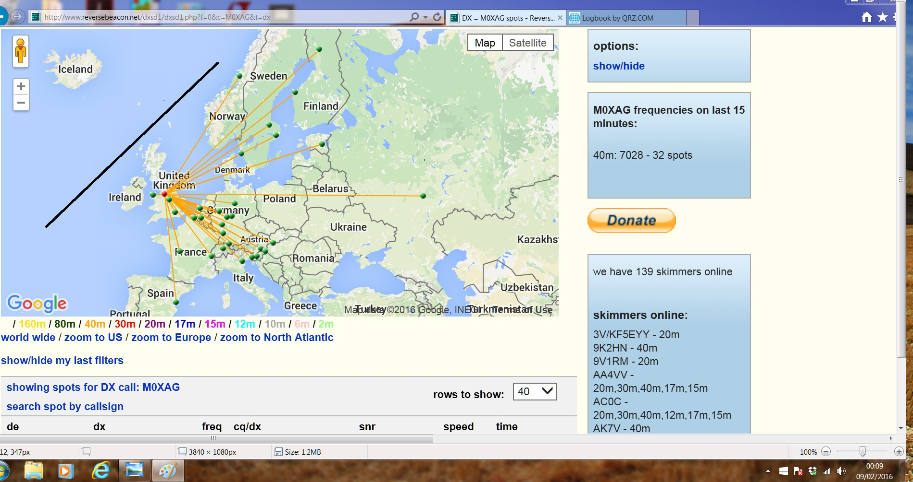
PERFORMANCE 7 MGHZ

Slide 24
OTHER DESIGNS........

Slide 25
OTHER DESIGNS........

Slide 26
OTHER DESIGNS........

Slide 27
OTHER DESIGNS........

Slide 28
OTHER DESIGNS........

Slide 29
OTHER DESIGNS........

Slide 30
OTHER DESIGNS........

Slide 31
OTHER DESIGNS........

Slide 32
APPROX COSTS...
COPPER £25
PLASTIC FRAME £30
CAPACITOR £35
MOTOR CONTROLLER & MOTOR £15
CAPACITOR HOUSING £35
SO239 £2
TOTAL +/- £142

Slide 33
QUESTIONS.................
THANKS M0XAG
END
THE

